Slide 1
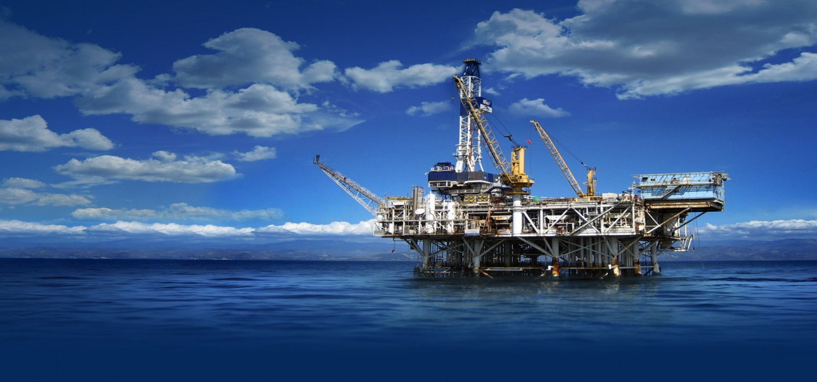

Penn State and the Global Oil and Gas Industry
Dr. Fariborz Ghadar
William A. Schreyer Professor of Global Management, Policies and Planning
Founding Director , The Center for Global Business Studies

Slide 2
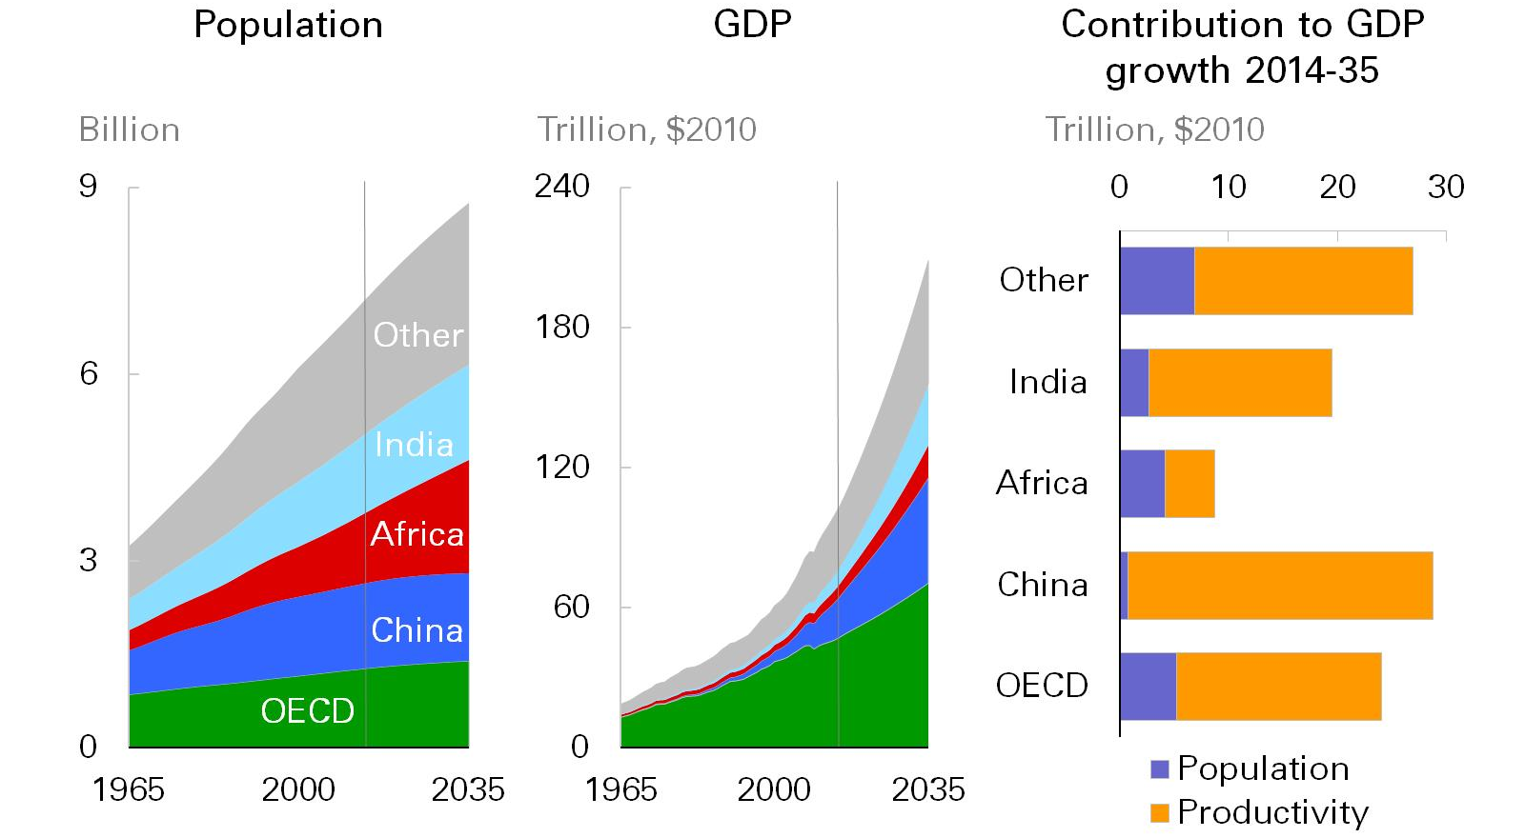

Global GDP is expected to more than double…
Global GDP Is Expected To More Than Double
Source: BP
Dr. Fariborz Ghadar

Slide 3
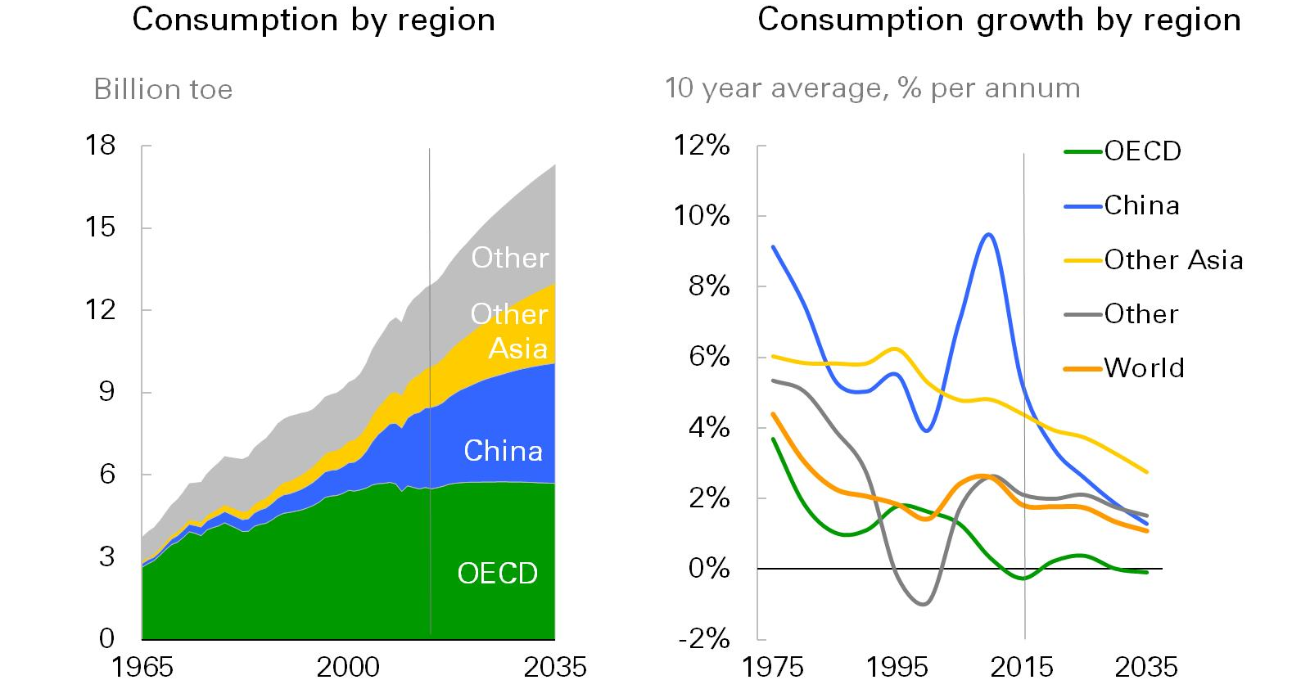
Growth in the world economy requires more energy…
Growth In The World Economy Requires More Energy
Source: BP
Dr. Fariborz Ghadar

Slide 4
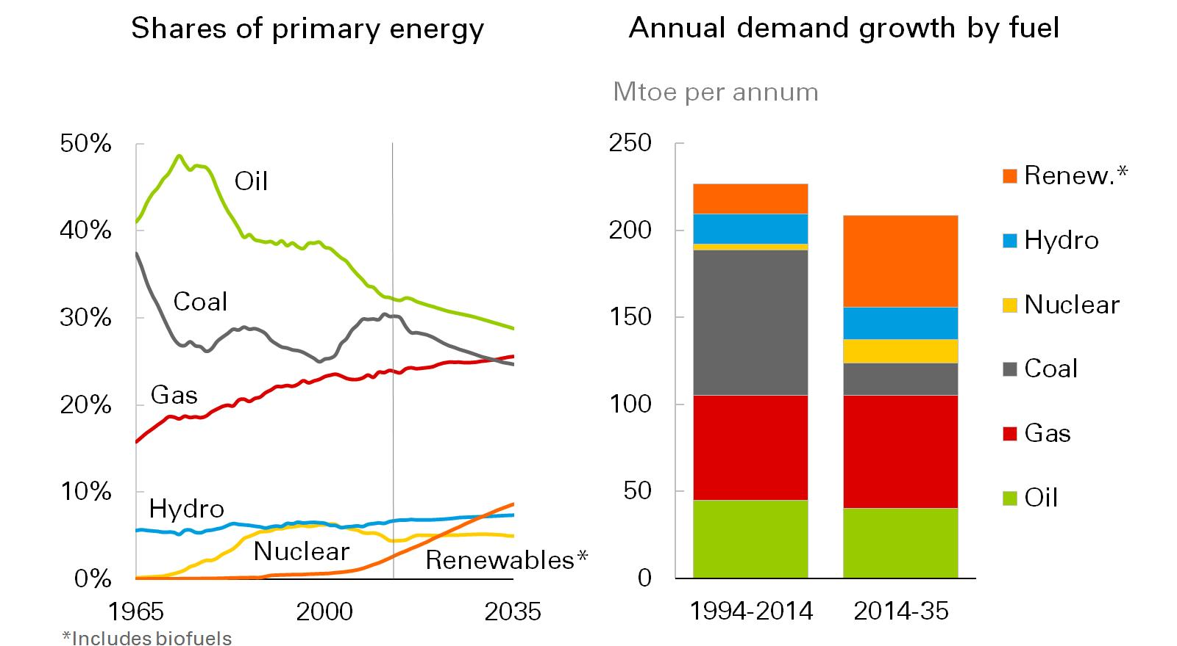
The fuel mix is set to change significantly…
The Fuel Mix Is Set To Change Significantly
Source: BP
Dr. Fariborz Ghadar

Slide 5
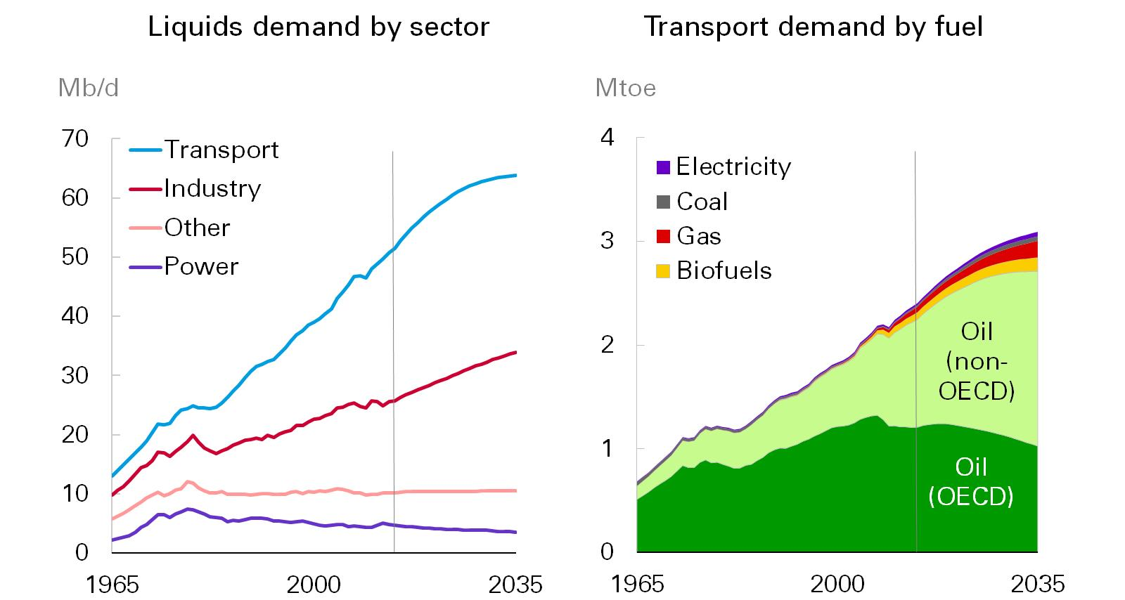
Growth in liquids demand is driven by transport and industry…
Growth In Liquids Demand Is Driven By Transport And Industry
Source: BP
Dr. Fariborz Ghadar

Slide 6
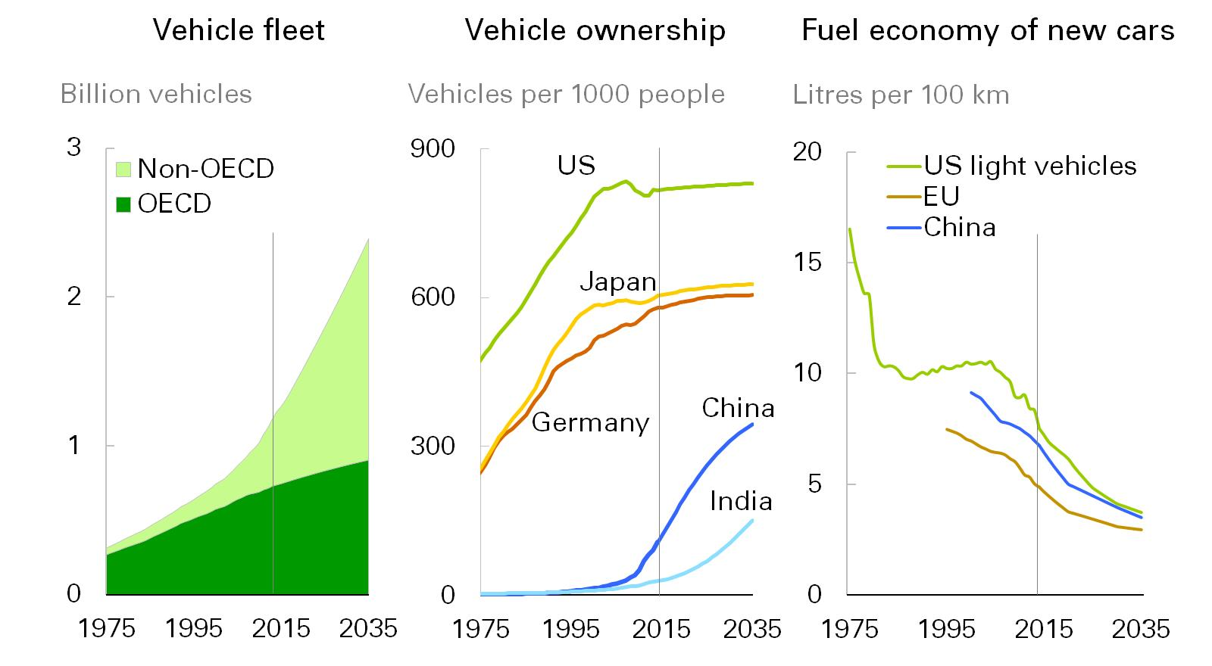
The global vehicle fleet more than doubles…
The Global Vehicle Fleet More Than Doubles
Source: BP
Dr. Fariborz Ghadar

Slide 7
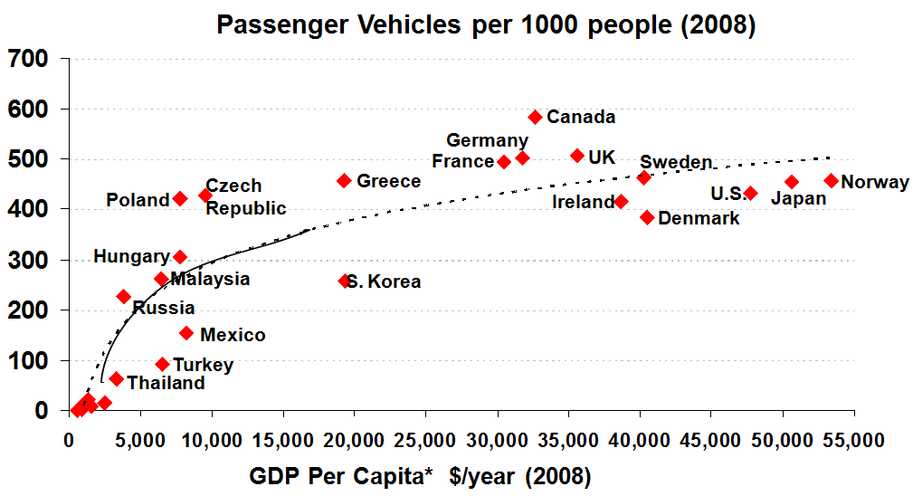
Passenger Vehicle Ownership vs. Per-Capita GDP
* 2009 USD
Indonesia (21) Philippines (8)
India (8) China (14)
Pakistan (3) Bangladesh (0)
China and India can expect exponential growth in passenger vehicle ownership
Sources: World Bank & Wards Auto
7
Dr. Fariborz Ghadar
SJR 01/06/10
Notes:
I would not like to move to developing country demand. One reason why developing
country demand is projected to increase is strong population growth. World population is
expected to grow by about 20% or 1.4 billion people (6.8 to 8.2 billion) by 2030. Almost all
of the growth is in developing countries. Strong population growth will lead to higher energy
use.
In addition to rising population growth , many developing countries have rapid growth in per
capita income, and when they reach a certain threshold ($5,000 USD GDP per capita) they
experience exponential growth in their ability to purchase vehicles and appliances.
This chart shows that countries like China and India are entering the exponential part of the
curve for vehicle ownership per one thousand people (Y axis) as their GDP per capita rises
(X axis). Thus, we are likely to see strong oil demand growth in these countries. While they
will likely adapt efficiency mandates for balance of trade purposes, the invention of a very
low-cost vehicle for the masses like Tata’s Nano car (went on sale in India for a little over
$2,000 in March 2009) will likely offset any efficiency improvements that are made.

Slide 8
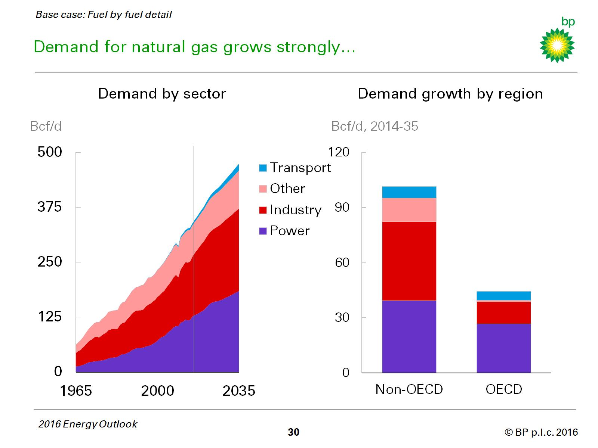
Demand for Natural Gas Grows Strongly
Source: BP
Dr. Fariborz Ghadar

Slide 9
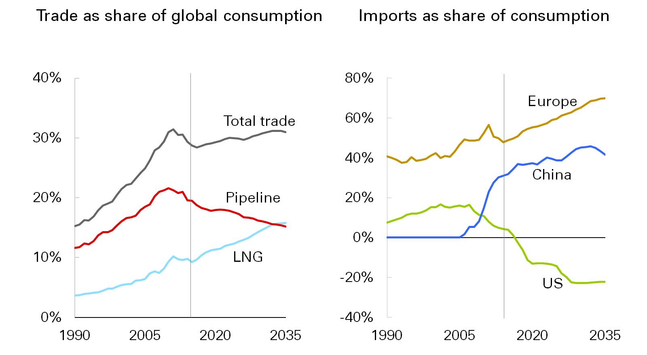
Trade in gas grows broadly in line with global consumption…
Trade In Gas Grows Broadly In Line With Global Consumption
Source: BP
Dr. Fariborz Ghadar

Slide 10
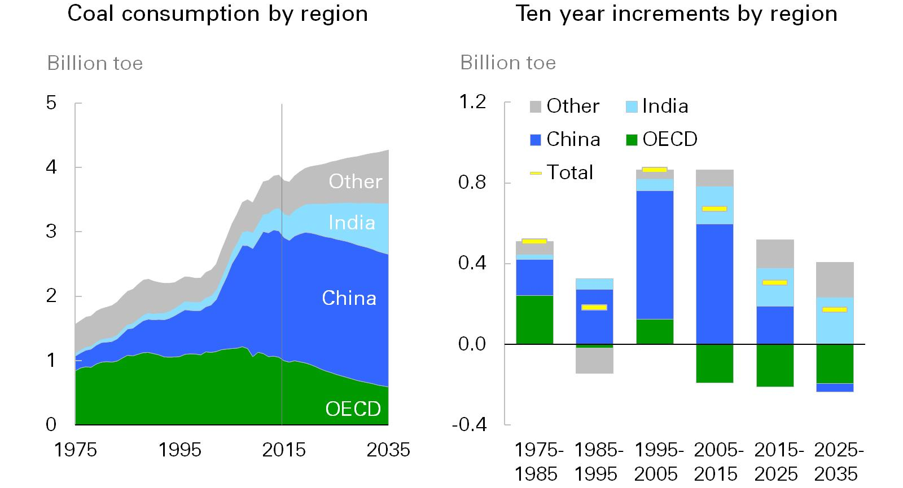
`
Growth in Global Coal Demand Slows Sharply
Source: BP
Dr. Fariborz Ghadar

Slide 11
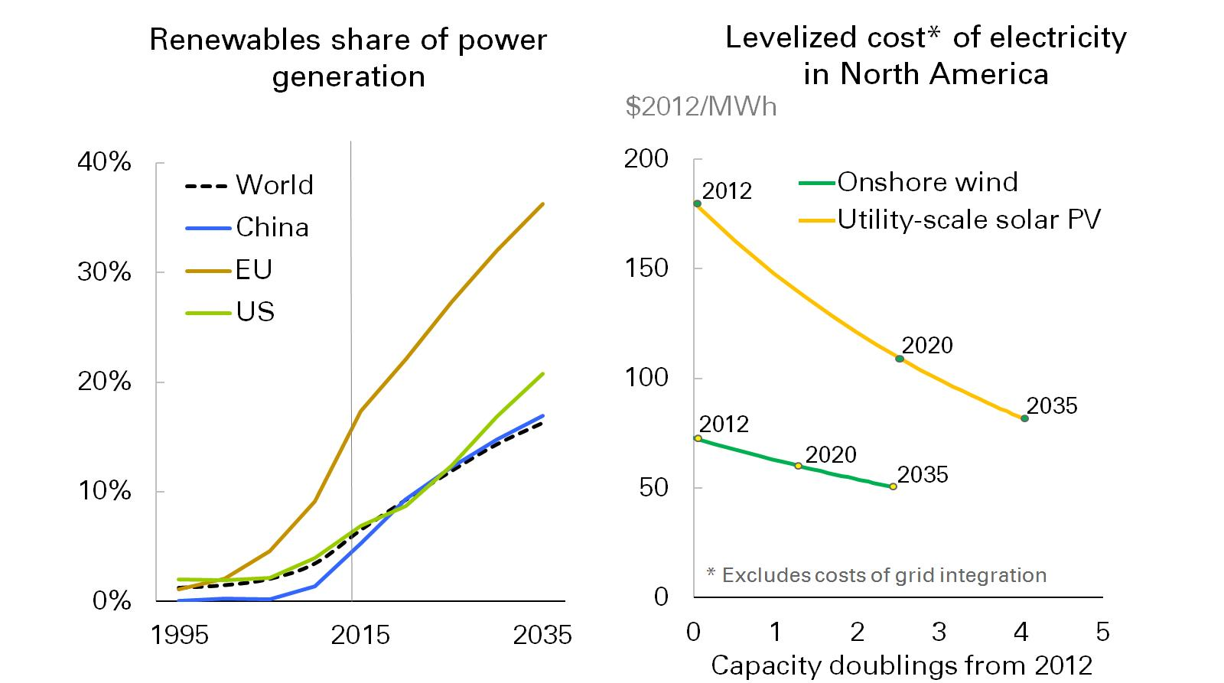
Renewables continue to grow rapidly…
Renewables Continue To Grow Rapidly
Source: BP
Dr. Fariborz Ghadar

Slide 12
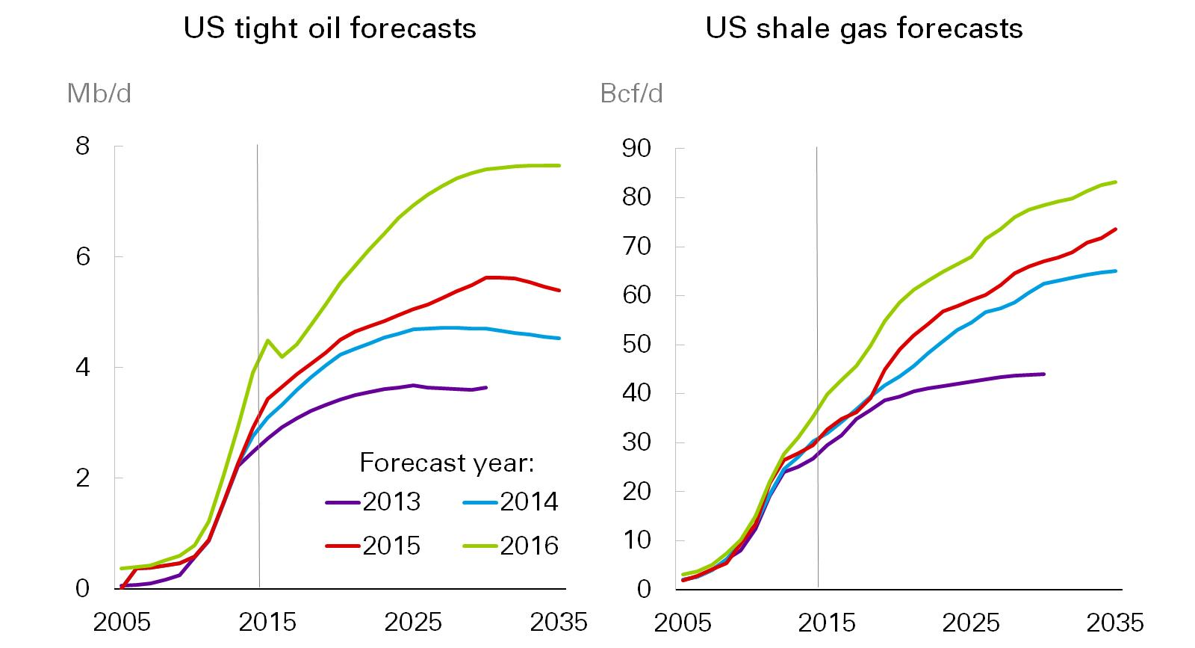
The outlook for US shale has been revised up repeatedly…
The Outlook For US Shale Has Been Revised Up Repeatedly
Source: BP
Dr. Fariborz Ghadar

Slide 13
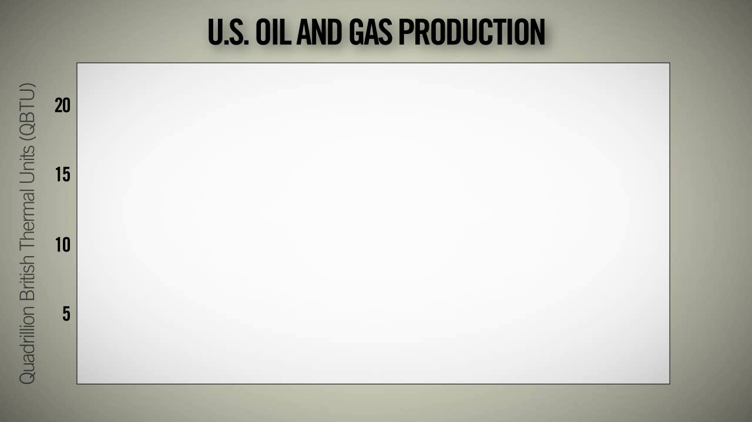
Dr. Fariborz Ghadar

Slide 14
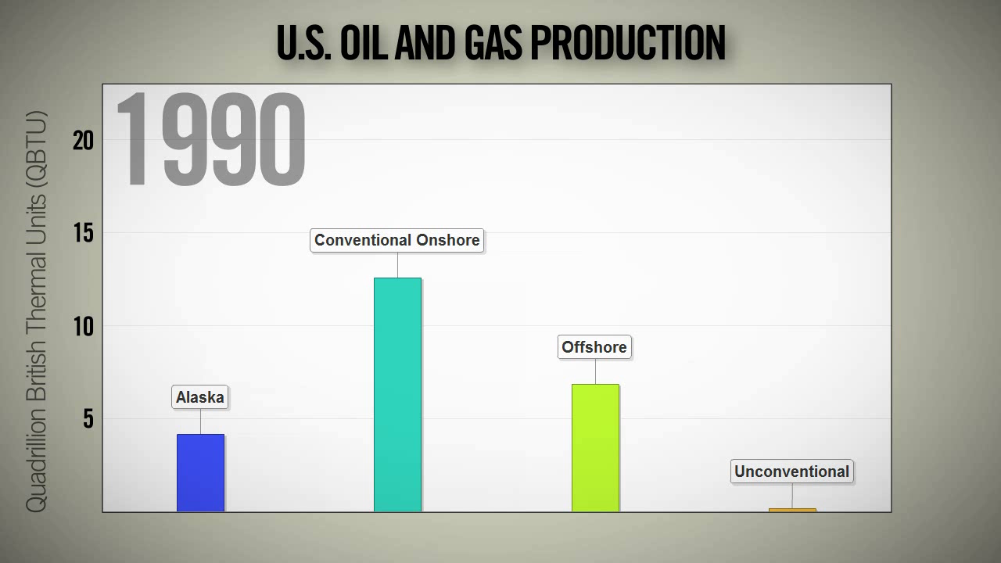
Dr. Fariborz Ghadar

Slide 15
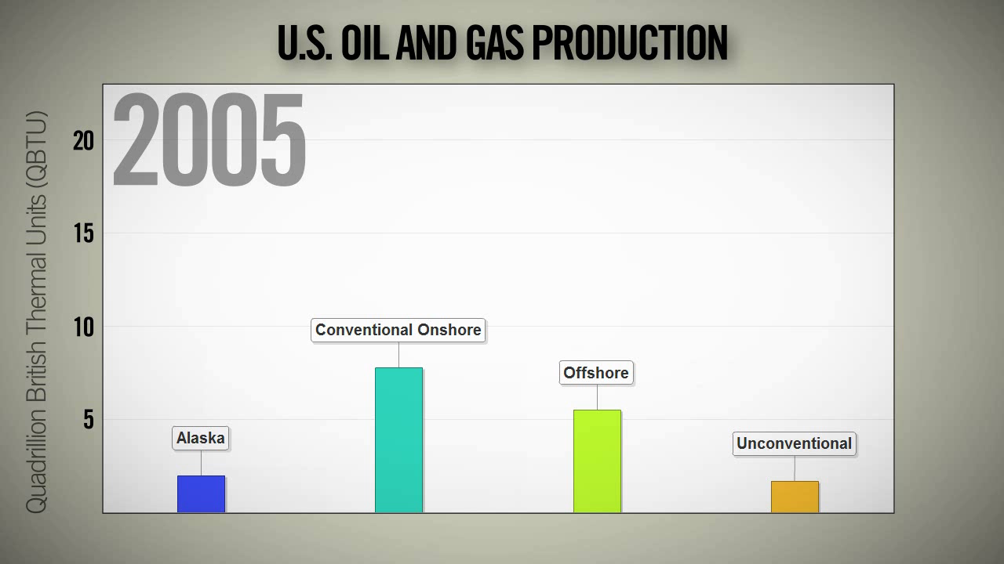
Dr. Fariborz Ghadar

Slide 16
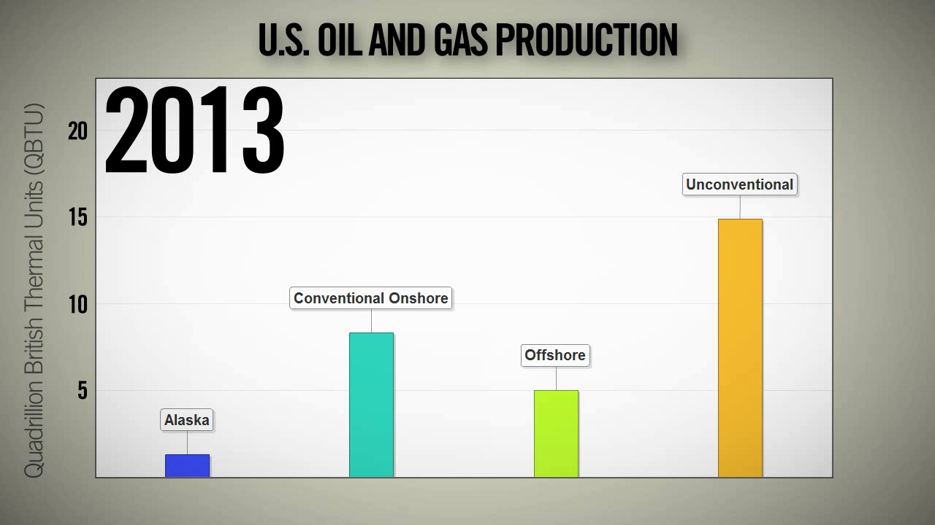
Dr. Fariborz Ghadar

Slide 17
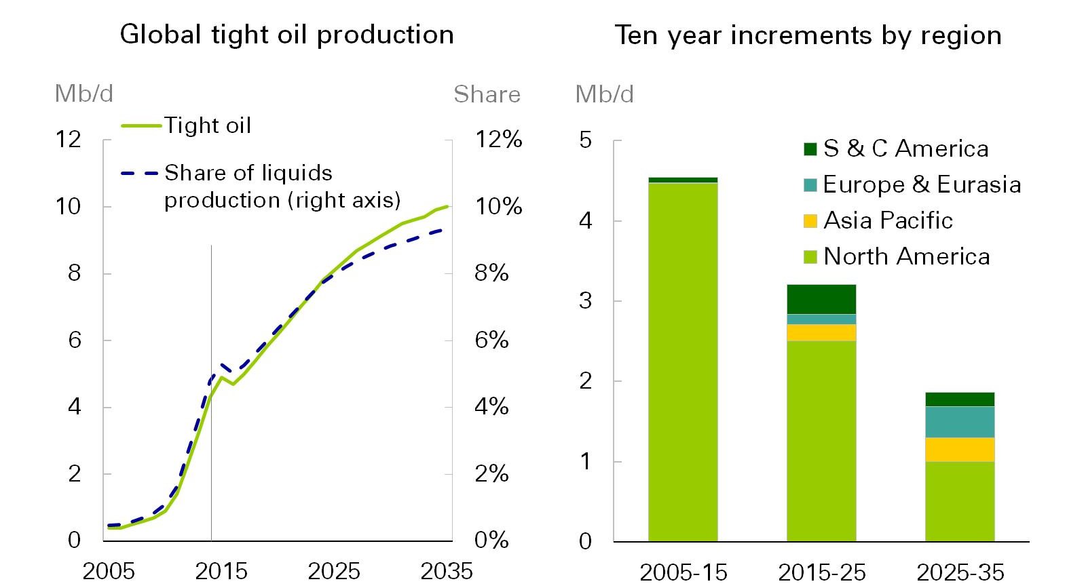
The Global Growth In Tight Oil Slows
Source: BP
Dr. Fariborz Ghadar

Slide 18
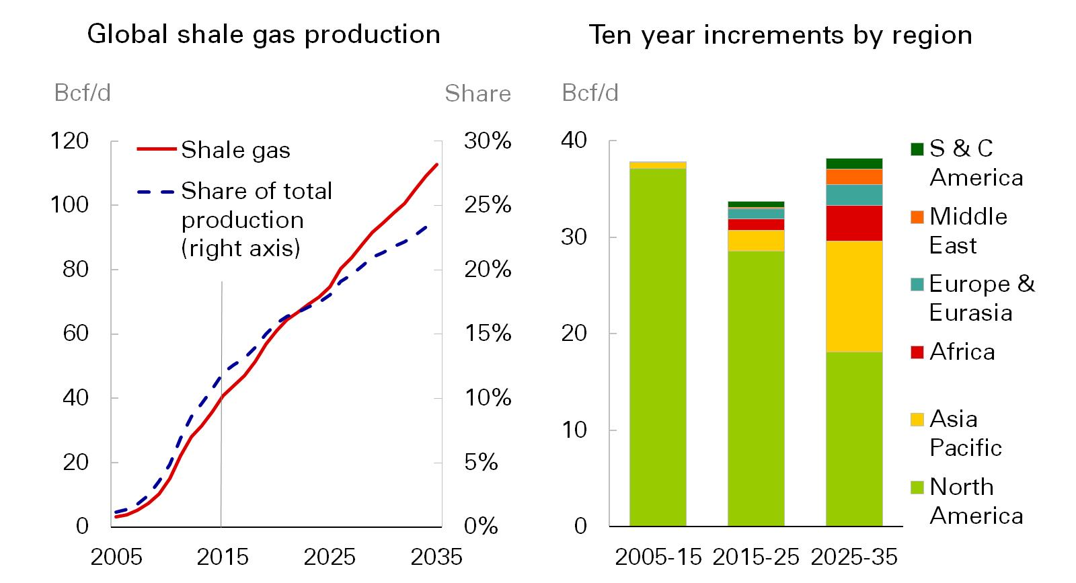
Shale Gas Production Continues To Expand Rapidly
Source: BP
Dr. Fariborz Ghadar

Slide 19
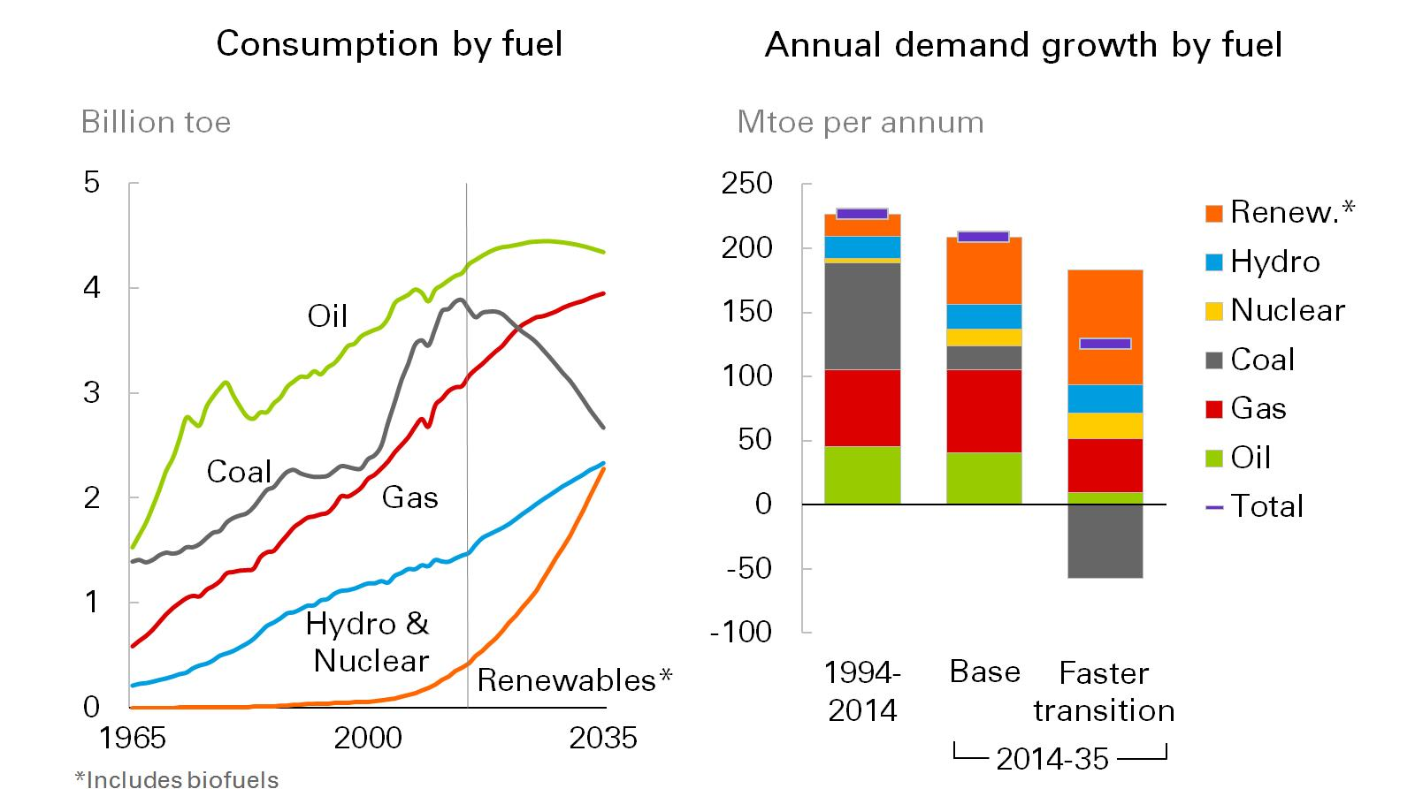
The faster transition has a significant impact…
The Faster Transition Has A Significant Impact
Source: BP
Dr. Fariborz Ghadar

Slide 20
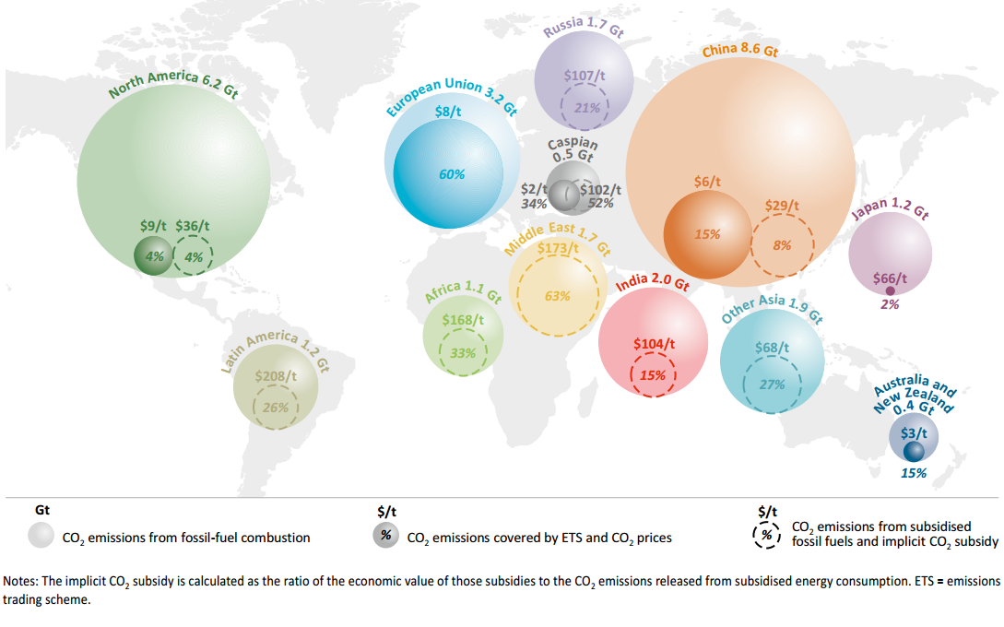
Energy-related CO2 Emissions By Location, 2014
Emissions
Dr. Fariborz Ghadar

Slide 21
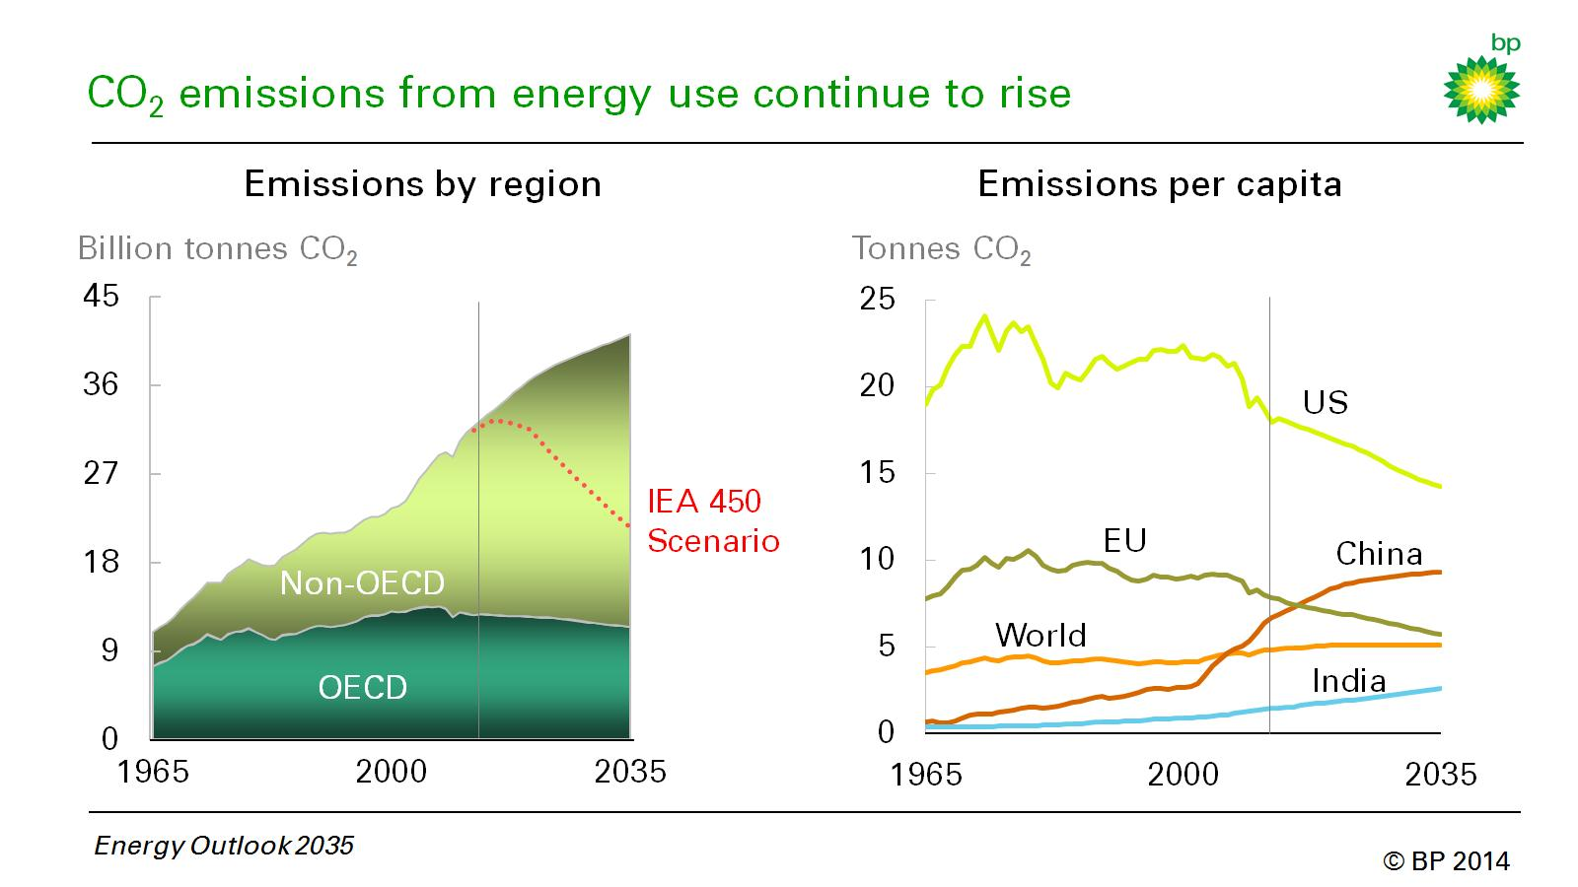
Emissions Per Capita
Source: BP, Energy Outlook 2035
Dr. Fariborz Ghadar

Slide 22
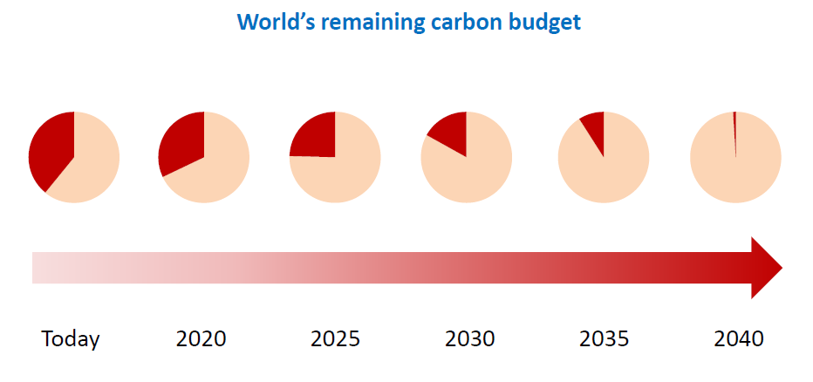
The Current Pathway Burns Up The Existing Carbon Budget Quickly
Emissions
Source: IEA
Dr. Fariborz Ghadar

Slide 23
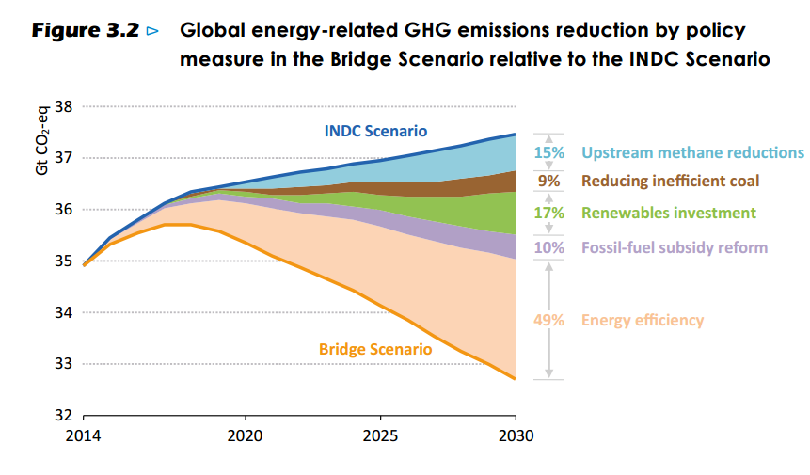
The Difference Between The “INDC” Scenario And The “Bridge” Scenario Is Substantial And Relies On 5 Measures
Emissions
Source: IEA
Dr. Fariborz Ghadar

Slide 24
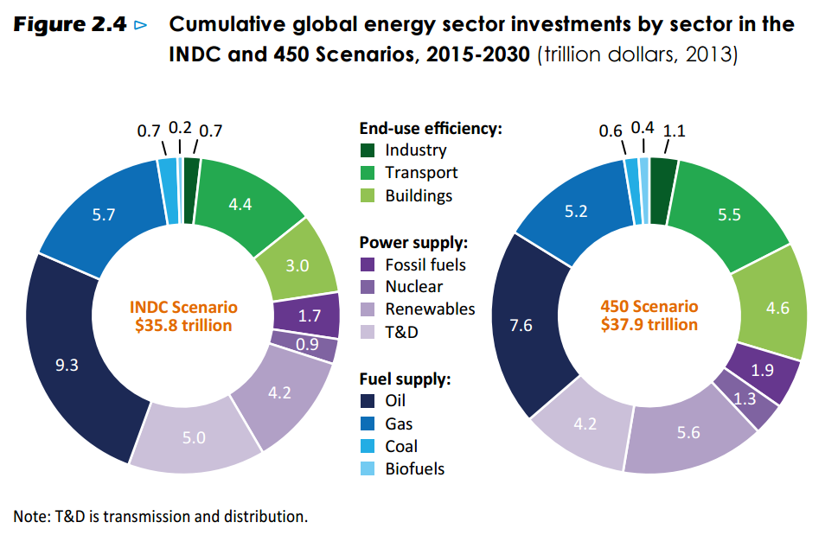
Investment Is Required Under All Scenarios
Emissions
Source: IEA
Dr. Fariborz Ghadar

Slide 25
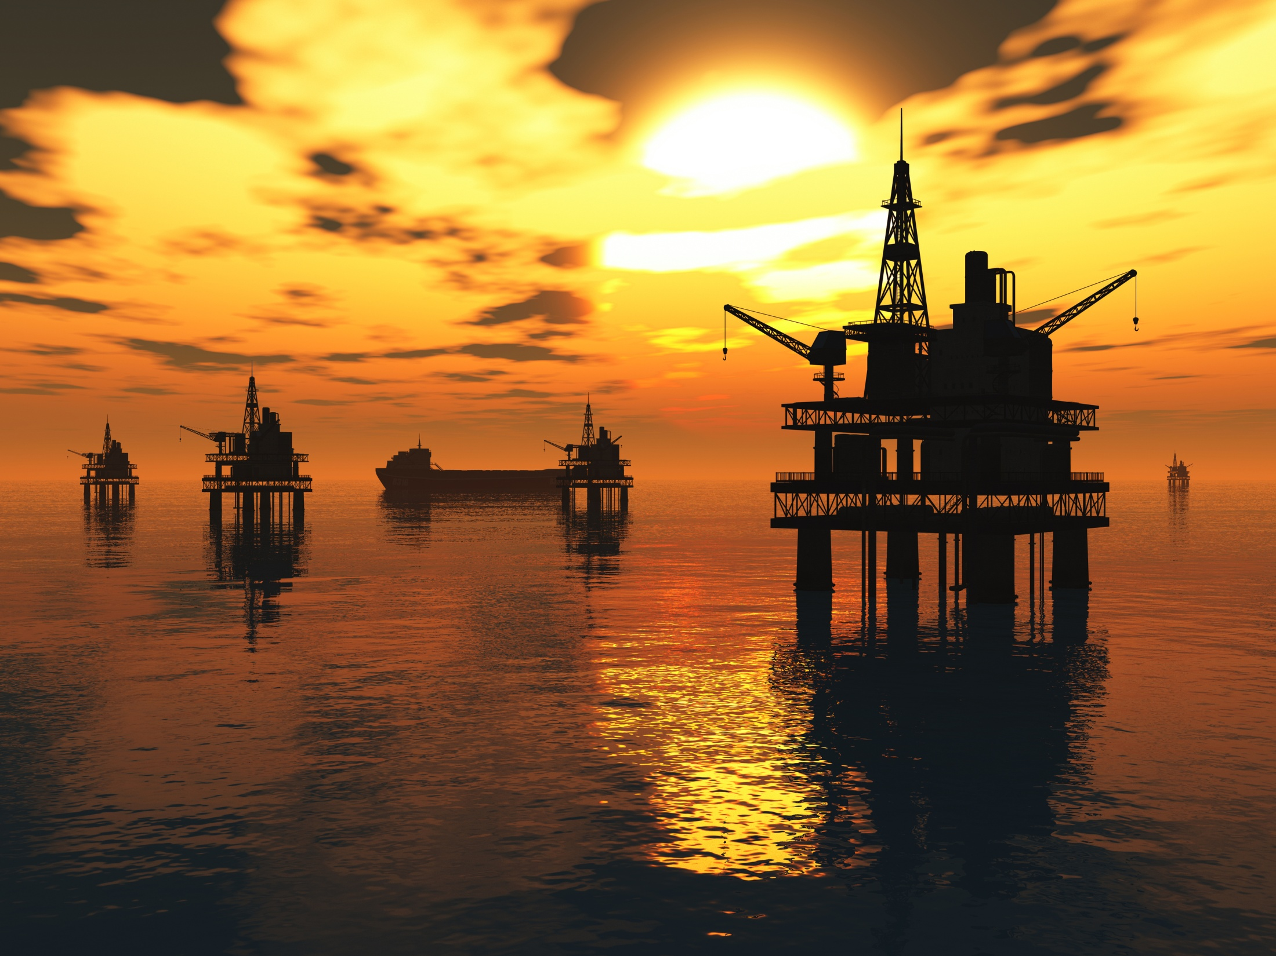
It is imperative that the world recognizes the importance of efficiency gains.

Slide 26
Higher levels of collaboration among industry, government and society at large is required to realize these gains.

Slide 27
The world has insatiably asked for more energy which companies have provided.
Beating up on energy companies is counterproductive.
The companies strive to listen and need to be included in the process.

Slide 28

Penn State is dedicated to helping the energy industry pivot in a new direction that ensures a more sustainable future.

Slide 29
Thank You.

